Slide 1
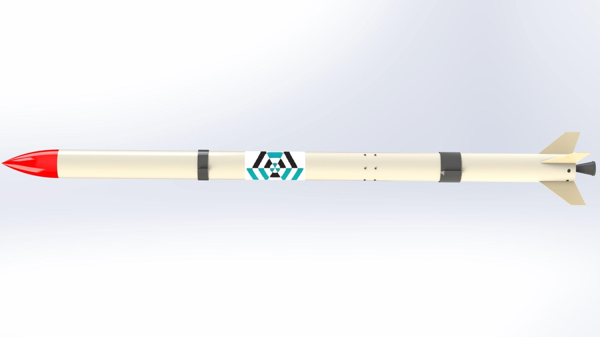
Airframe Progress Report
-12/4/2023-
no_reply@example.com

Slide 2
OVERVIEW
Assembly of Aluminium and Fiberglass Body Tube
Design of Launch Lug

Slide 3
Fiberglass Body Tube
The outer surface of the fiberglass airframe was prepared by sanding so as to remove the major discontinuities present on the surface.
After the preparation, a gloss coating was applied on the surface to get a smooth surface finish for painting.
#20

Slide 4
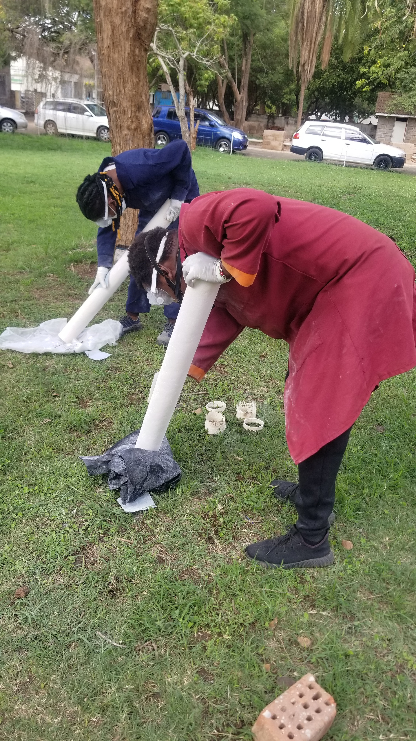
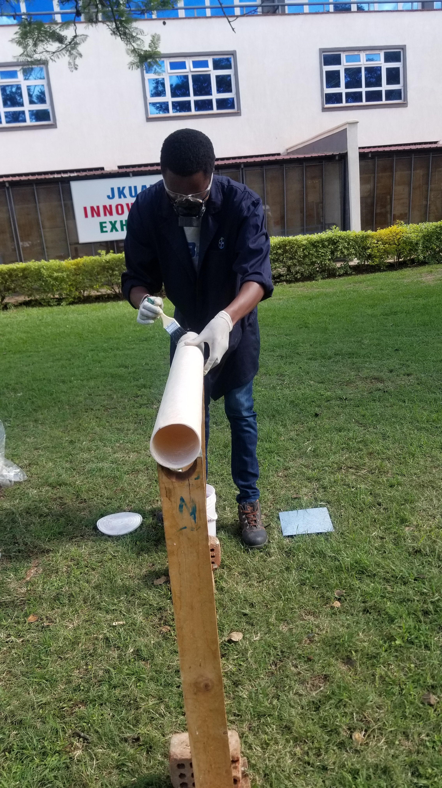
Preparation of the upper and lower airframe tubes
Application of gloss coating.

Slide 5
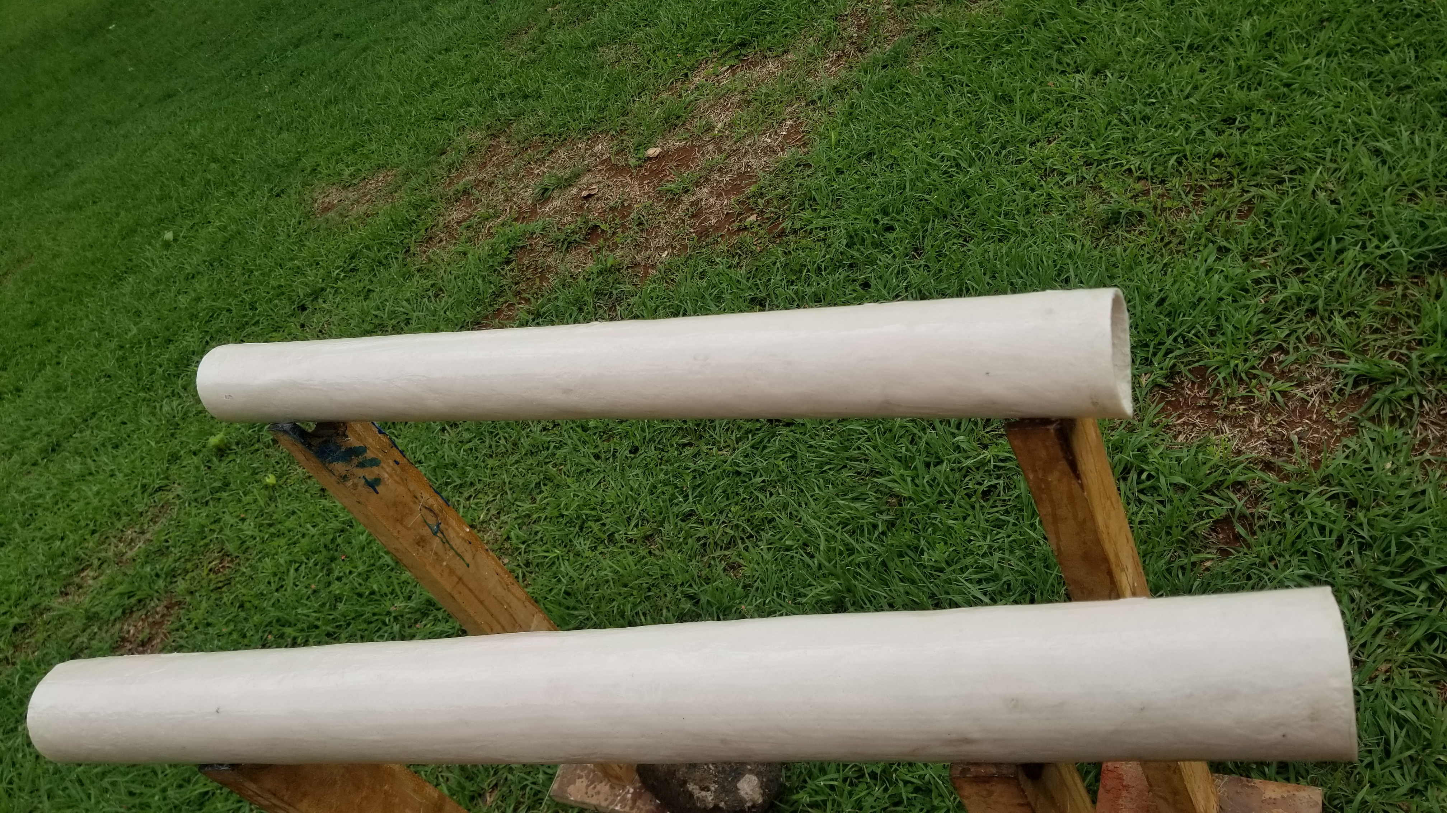
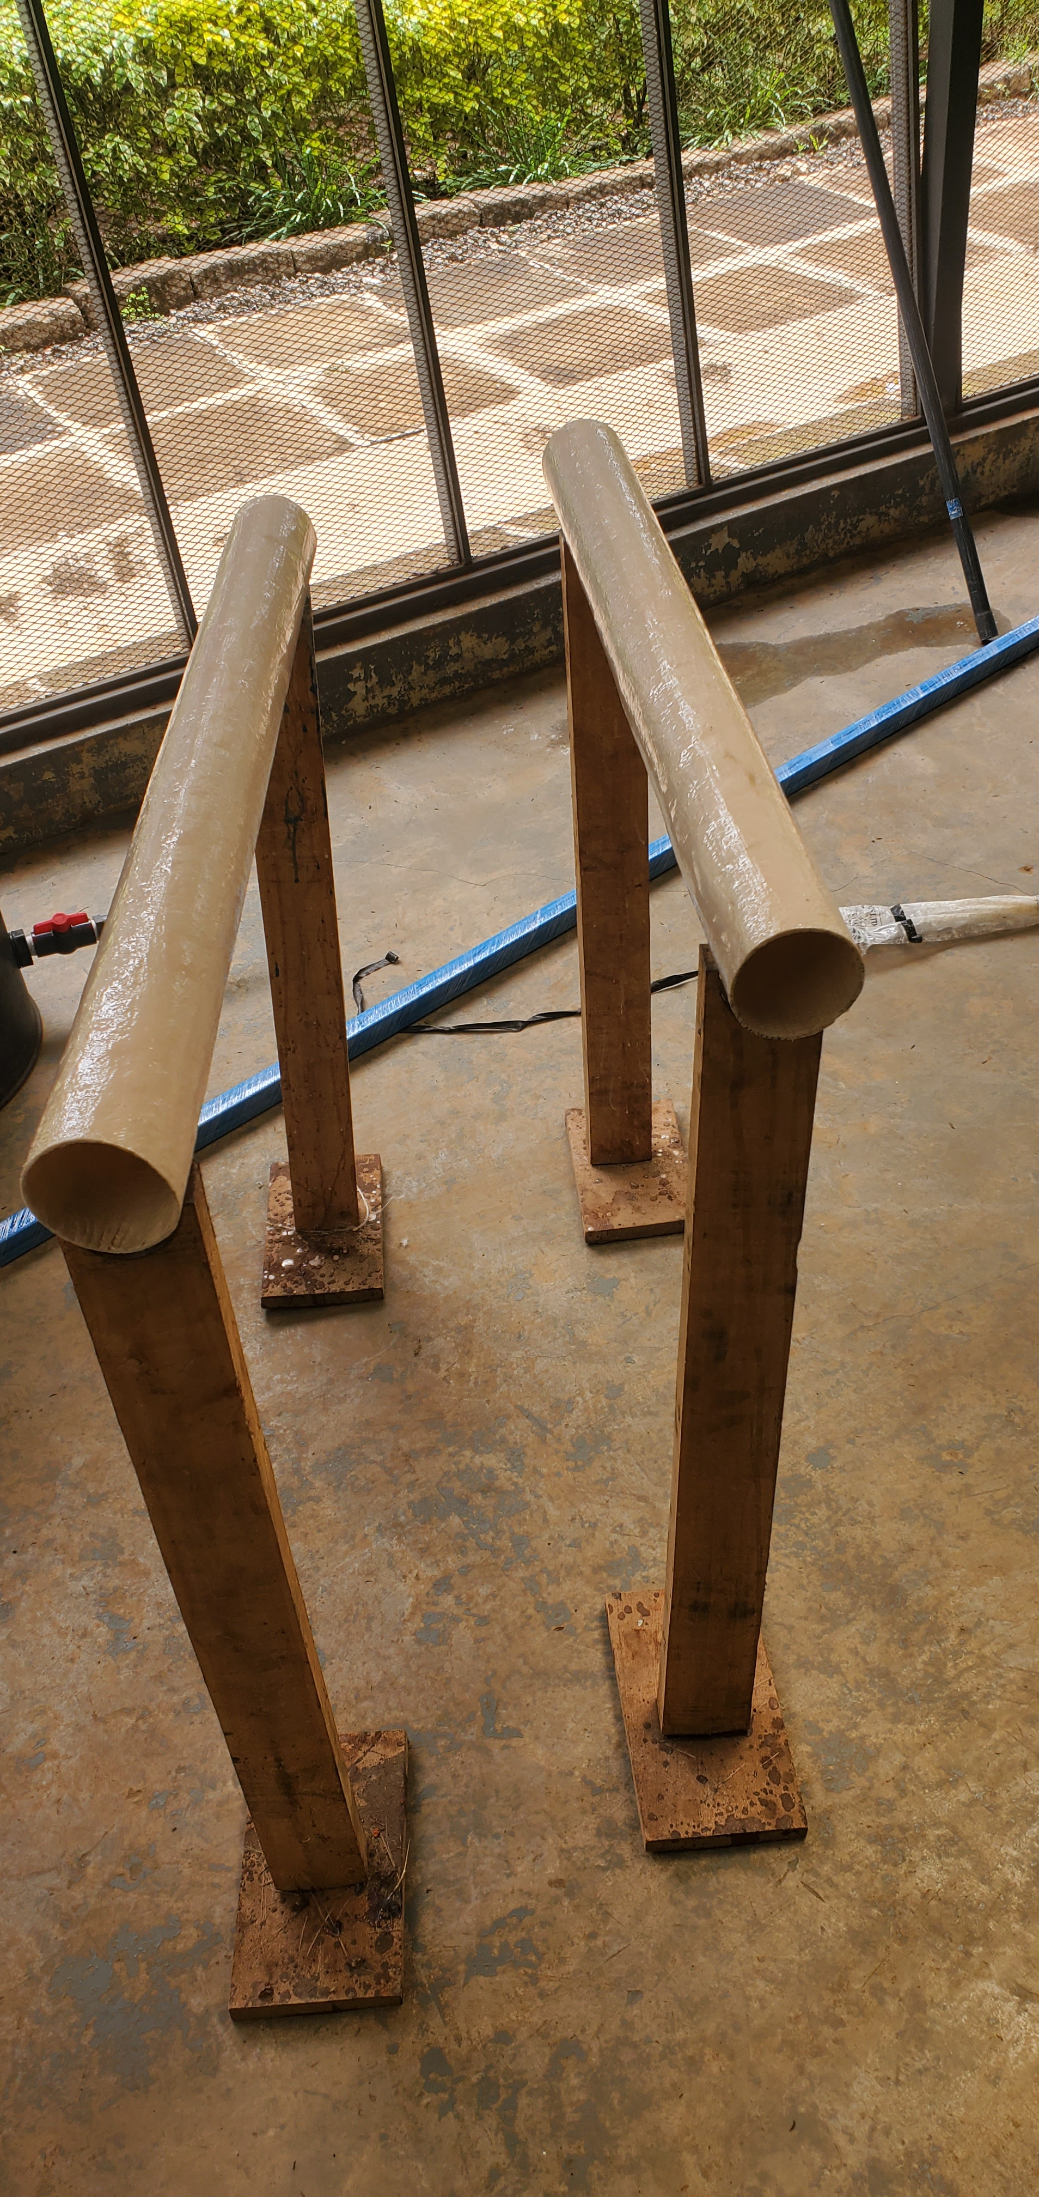
The tubes were left to dry after applying gloss.

Slide 6
Aluminium Body tube
We rolled the airframe into 3 different chassis(sections). Rolling it as a single long airframe had challenges as the center part could not be rolled perfectly.
We also rolled a doubler part which we will cut into various pieces when needed during various stages of airframe fabrication

Slide 7
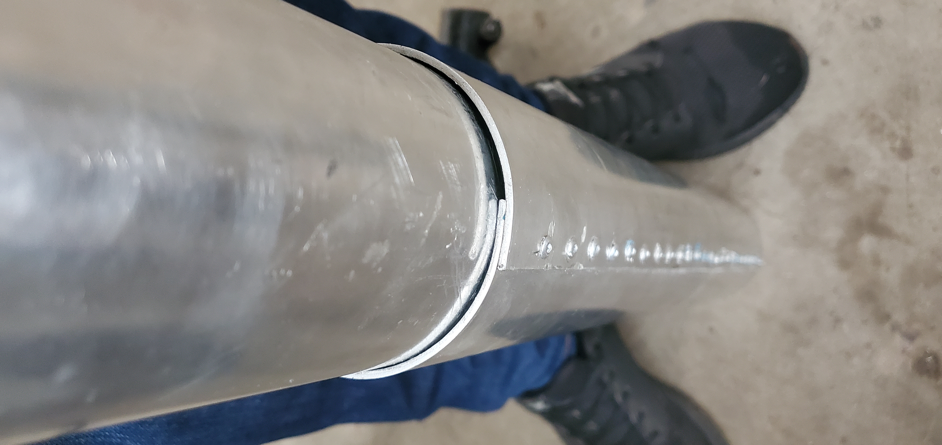
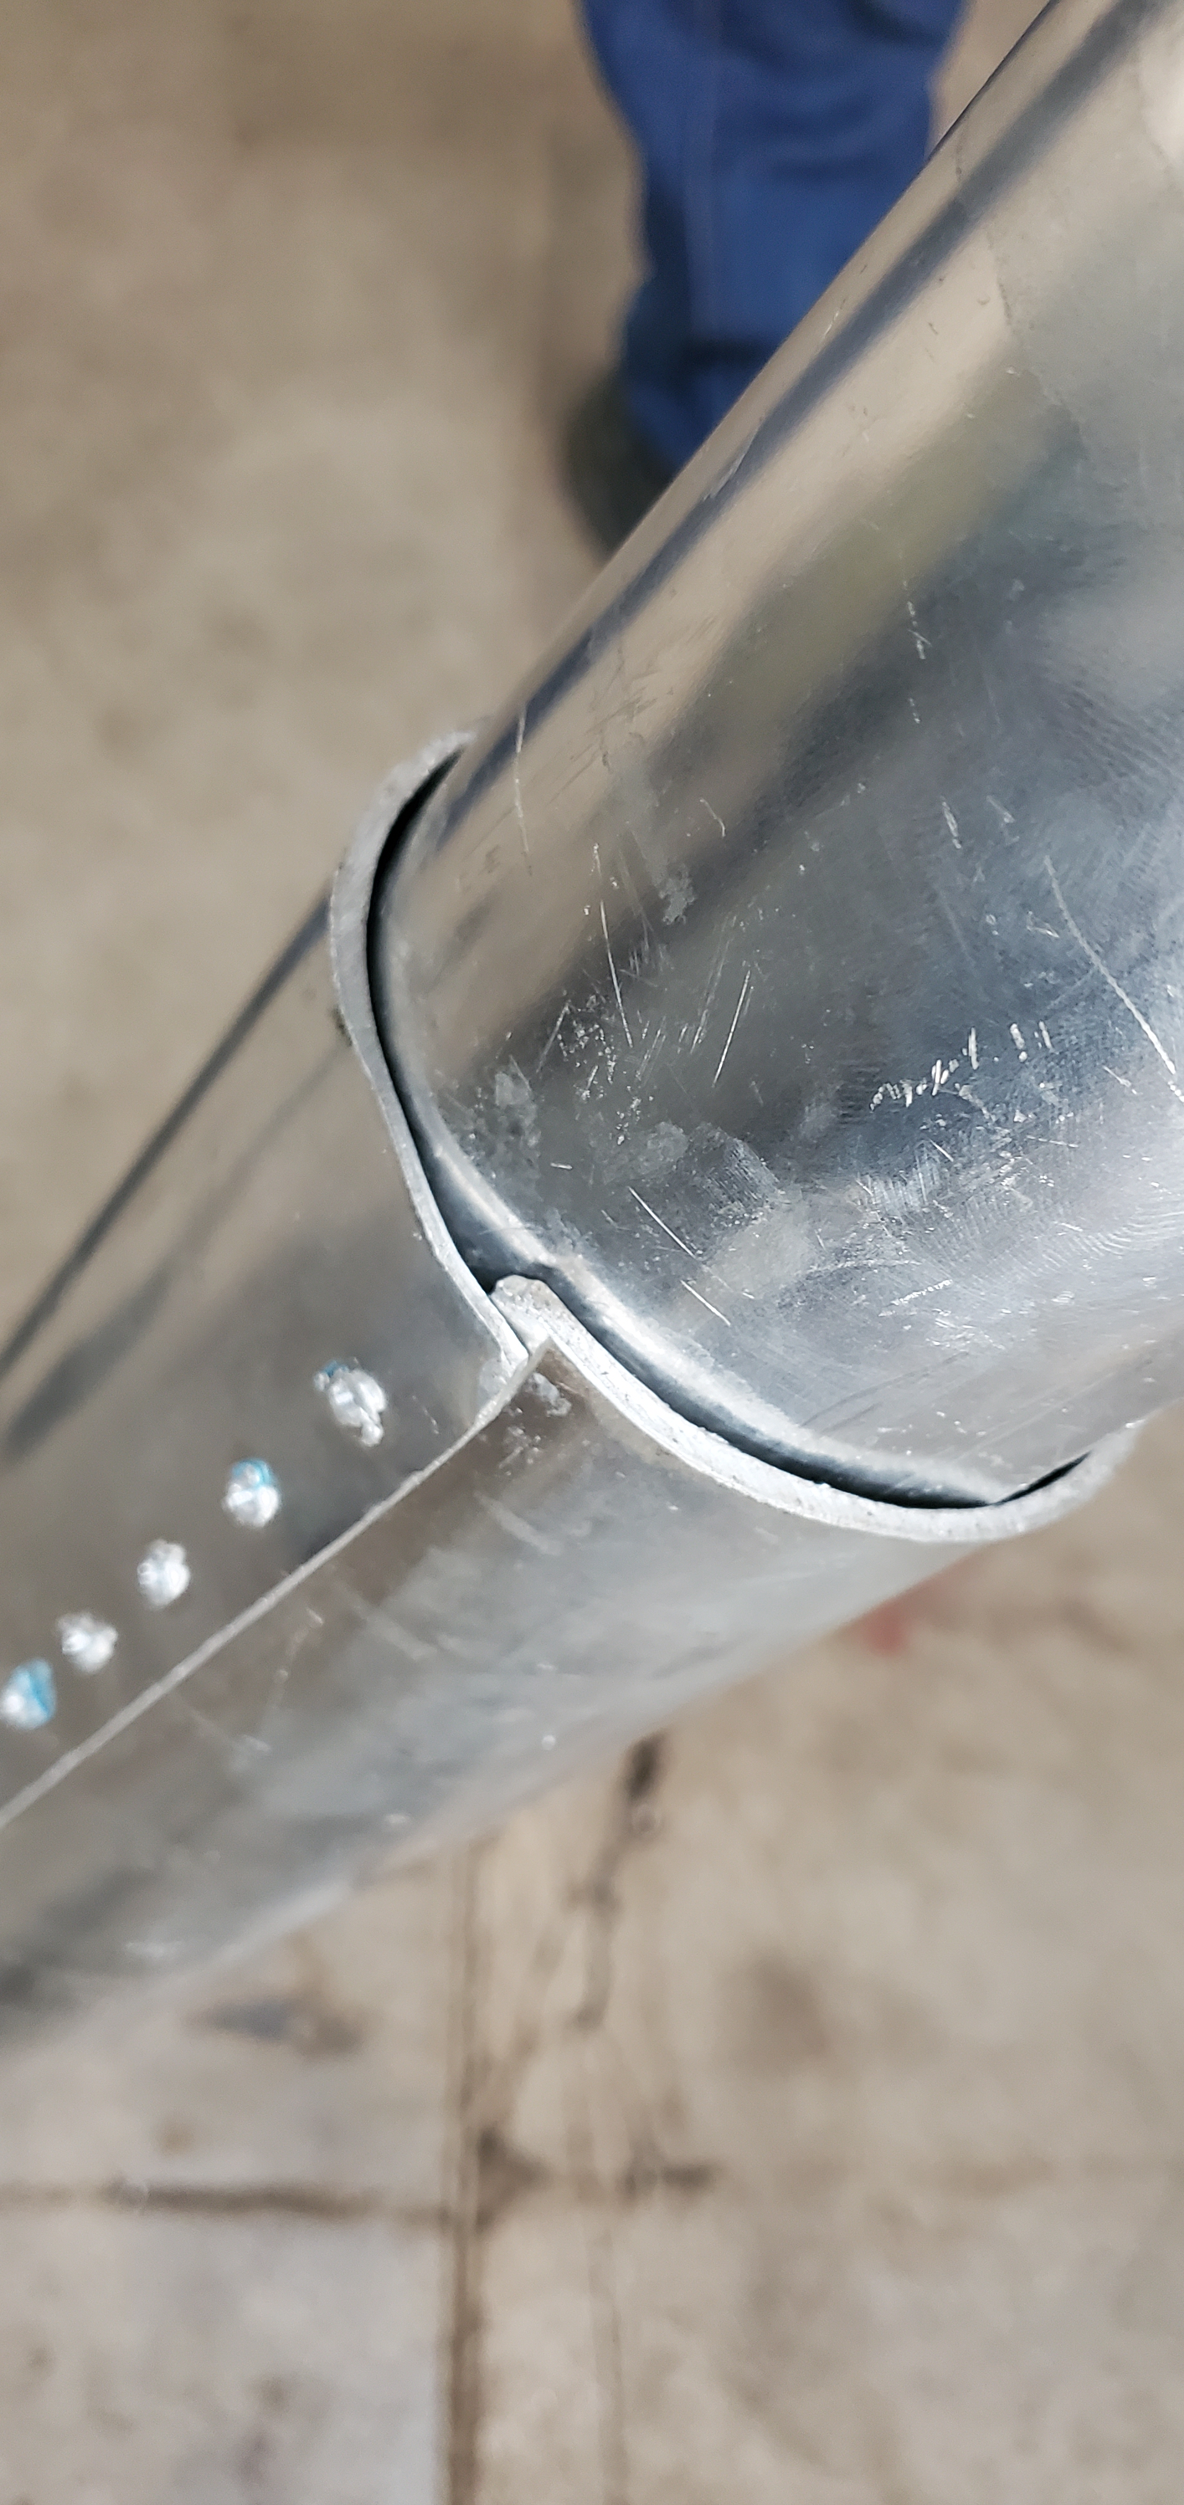
Finalized tube
Defective tube

Slide 8
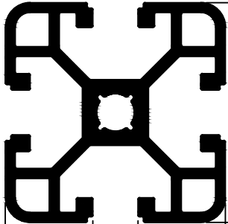
Launch lug design
An sketch of the aluminium extrusion/launch rail was taken from hydro-aluminium’s catalogue. This was used to design the outline of the launch lug.
The actual dimensions were taken using vernier calipers and a ruler.
40 mm
8.2 mm

Slide 9
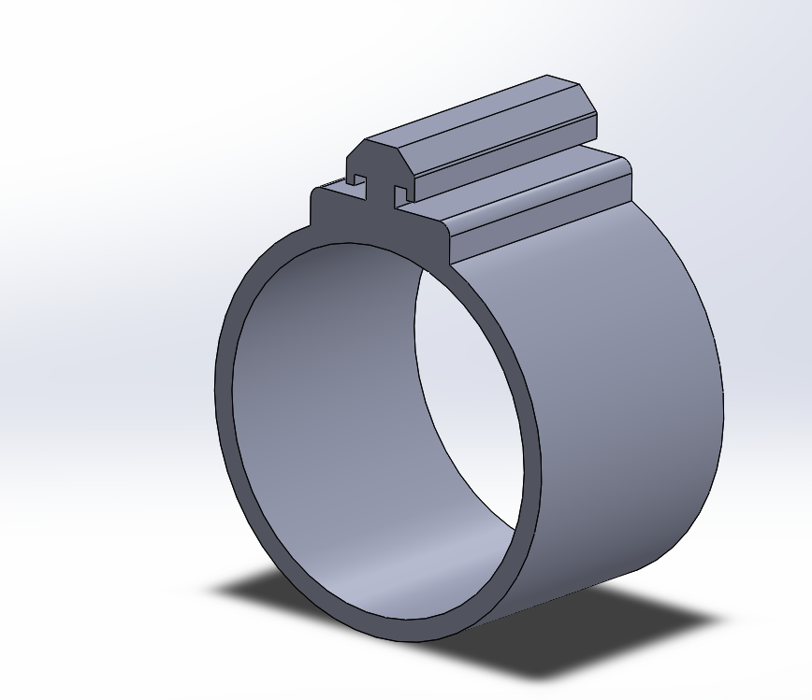

3D Model of the launch lug

Slide 10
NEXT WEEK’S OBJECTIVES
3D Printing of avionics bay, nosecone and Launch lug
Fabrication of the fin alignment jig

Slide 11
THANKYOU
Q/A

